Slide 1


Introduction to Data Sharing and Data Management Planning
Joy Davidson
Digital Curation Centre

Slide 2

“Data sets are becoming the new instruments of science”
Dan Atkins, University of Michigan

Slide 3
Exceptions to copyright
*Reforms to copyright law come into force on 1st June*
The exceptions coming into force today will bring a range of benefits to a wide range of groups:
Researchers will benefit from the introduction of the new text and data mining exception for non-commercial research, as well as the reforms to existing
Libraries, archives and museums will now be better able to protect our cultural heritage and preserve their collections. The existing preservation exception has been expanded to cover all types of copyright work, and now applies to museums and galleries as well as libraries and archives.

Slide 4

Funders’ expectations of public access
“Publicly funded research data are a public good, produced in the public interest, which should be made openly available with as few restrictions as possible in a timely and responsible manner that does not harm intellectual property.”
RCUK Common Principles on Data Policy
http://www.rcuk.ac.uk/research/Pages/DataPolicy.aspx

Slide 5
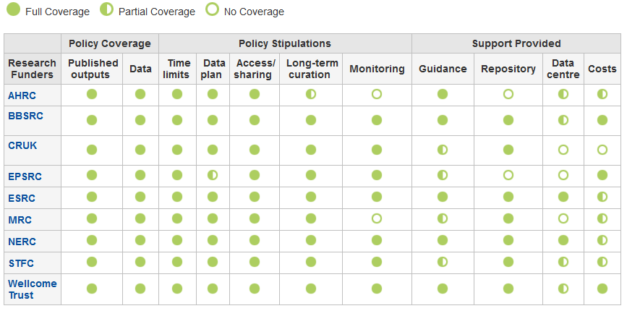
Research funder data policies
www.dcc.ac.uk/resources/policy-and-legal/ overview-funders-data-policies

Slide 6

“Research organisations will ensure that effective data curation is provided throughout the full data lifecycle, with ‘data curation’ and ‘data lifecycle’ being as defined by the Digital Curation Centre. The full range of responsibilities associated with data curation over the data lifecycle will be clearly allocated...”
...institutional responsibility
www.epsrc.ac.uk/about/standards/researchdata/Pages/expectations.aspx

Slide 7

Ultimately funders expect:
timely release of data
  once patents are filed or on (acceptance for) publication
open data sharing
  minimal or no restrictions if possible
preservation of data
  typically 5-10+ years if of long-term value
See the RCUK Common Principles on Data Policy:
www.rcuk.ac.uk/research/Pages/DataPolicy.aspx

Slide 8
Data Management Planning
Data Management Sharing
Data Management Planning

Slide 9
What is data sharing?
  “… the practice of making data used for scholarly
  research available to others.” [Wikipedia]
Who’s involved?
  the data sharer
  the data repository
  the secondary data user
  support staff
  research participants
  commercial partners

Slide 10

BENEFITS
Avoid duplication
Scientific integrity
More collaboration
Better research
Increased citation
9-30% increase shown in study
(Piwowar H. and Vision T.J 2013 , https://peerj.com/preprints/1.pdf)

Slide 11
Managing restrictions on sharing
  Ethics
  Balance data protection with data sharing
  Informed consent – cover current and future use
  Confidentiality – is anonymisation appropriate?
  Access control – who, what, when?
  IPR
  Clarify copyright before research starts
  Consider licensing options e.g. Creative Commons

Slide 12
How to share research data
Use appropriate repositories and data catalogues
  http://databib.org
  http://www.re3data.org/
  Jisc/DCC research data registry (coming soon!)
License the data so it is clear how it can be reused
  www.dcc.ac.uk/resources/how-guides/license-research-data
Make sure it’s clear how to cite the data
  http://www.dcc.ac.uk/resources/how-guides/cite-datasets
Consider publishing a data paper based on your DMP http://metajnl.com/

Slide 13

Thanks – any questions?
DCC guidance, tools and case studies:
www.dcc.ac.uk/resources
Follow us on twitter:
@digitalcuration and #ukdcc

